Slide 1
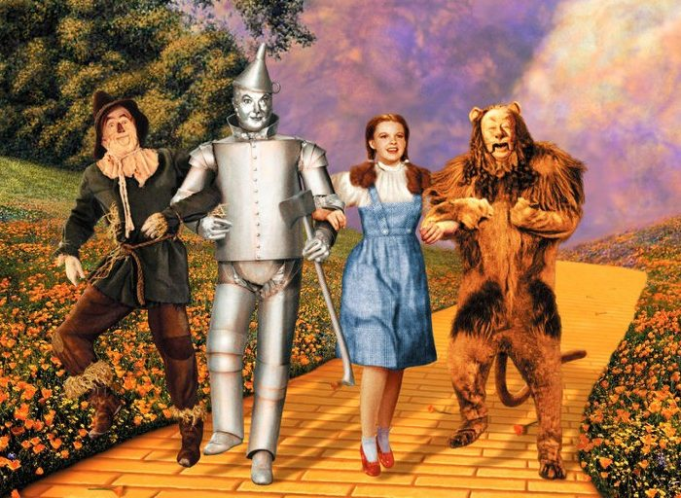
Vectors and Functions and For Loops, Oh my!

Slide 2
How R Does Math
Need * between ALL multiplication
Write fractions like this:
(2 / 3)
π written as pi
Exponents written as ^

Slide 3
Structure of a Function
Give it a name….
So you can call it!
Can be anything as long as it matches
The input the function will receive
Open and close “doing” with curly brackets
Name = function(x) {stuff you’re doing pertaining to x}
A function
Will always be “function”
Must match what’s in parentheses

Slide 4
What Makes a Vector
Give it a name….
To make it an object…
So you can call it!
Elements in the vector
Elements must be enclosed by parentheses
VectorName = c(1, 2, 3, 4, 5)
All elements separated by a comma!
Not a vector unless
you have a c!

Slide 5
Structure of a For Loop
Can be anything as long as it matches
Must match what’s in parentheses
Open and close “doing” with curly brackets
for (x in vectorName) {stuff you’re doing with x}
Always starts with “for”
Must match vector

Slide 6
Printin’ Pretty
print()
cat()
Add text in quotes
\n adds new lines

Slide 7
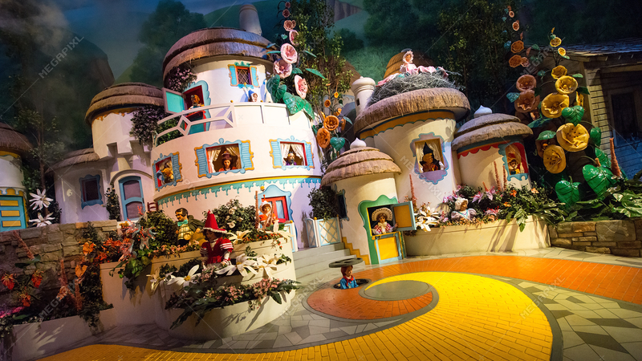
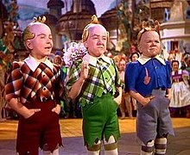

Help out the Lollipop Guild!
Convert their lollipops’ radius to circumference!
Equation is 2 π r

